Slide 1
Preventative Risk Factors for Diabetes
Presented By: Swathi Das

Slide 2

Introduction
Diabetes is one of the most prevalent chronic diseases in the US. It is suspected that diabetes and its prevalence varies by age, education, income, location, race, and other social determinants of health. This analysis will dive into this topic and seek to provide insight into risk factors that are most predictive of diabetes risk.
The dataset is from the Behavioral Risk Factor Surveillance System (BRFSS) and the Centers for Disease Control and Prevention (CDC).
The dataset consists of 70,692 survey responses 22 columns and I will be taking a closer look at BMI, Could not see Doctor due to Cost, and Income.

Slide 3



Research Questions
Is there is a significant difference between the BMI for patients with diabetes versus without diabetes?
Is there a significant difference in the proportion of patients with diabetes who did not see the doctor due to cost and those patients who did see the doctor?
Is there is a significant difference in the proportion of patients with diabetes and patients who make below poverty level income and patients who make above poverty level income?

Slide 4
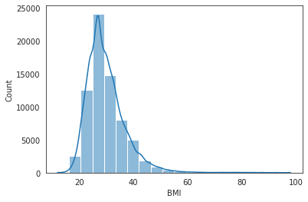
Patient’s BMI
Distribution of BMI
Hypothesis
Null Hypothesis: There is no statistically significant difference between BMI for patients with diabetes or without diabetes.
Alternative Hypothesis: There is a statistically significant difference between BMI for patients with diabetes or without diabetes.
Notes:
The BMI group had a sample size over 30 and the sample’s data follows a near-normal distribution.
T-test - a statistical test that is used to compare the means of two groups
P-value - how likely it is that your data would have occurred under the null hypothesis of your statistical test

Slide 5
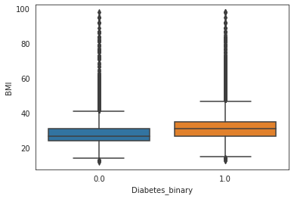
Patient’s BMI
Analysis
The p-value is 0.0 which is smaller than our alpha.
We reject Ho (null hypothesis) as the data provides convincing evidence to suggest Ho is wrong.
We are 95% confident the population difference in means lies between -1.01 and -0.95.
The difference between the average BMI of patients with diabetes and without diabetes is statistically significant, using a significance level of 0.05.
The average BMI for a person without diabetes is around 28 while the average BMI for a person with diabetes is 32.
Notes:
The box plot visualizations show that BMI is lower in patients without diabetes.
T-test - a statistical test that is used to compare the means of two groups
P-value - how likely it is that your data would have occurred under the null hypothesis of your statistical test

Slide 6
Patient needed to see the doctor
Hypothesis
Null Hypothesis: There is no statistically significant difference in the proportion of patients with diabetes who did not see the doctor due to cost and patients who did see the doctor.
Alternative Hypothesis: There is a statistically significant difference in the proportion of patients with diabetes who did not see the doctor due to cost and patients who did see the doctor.
Notes:
Could see doctor 49%
Could not see doctors 56%
P-value - how likely it is that your data would have occurred under the null hypothesis of your statistical test
A two proportion z-test allows you to compare two proportions to see if they are the same.

Slide 7
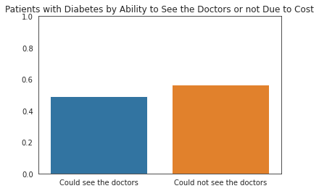
Patient needed to see the doctor
Analysis
The p-value is 1.22*10^-27, which is a lot smaller than our alpha.
We reject Ho (null hypothesis) as the data provides convincing evidence to suggest Ho is wrong.
The difference in proportion between the patients with diabetes who did not go to the doctors due to cost and patients that could see the doctor is statistically significant, using a significance level of 0.05.
Patients that have diabetes and could not see the doctor due to cost is up by 7%, compared to patients that could see a doctor.
Notes:
Was there a time in the past 12 months when you needed to see a doctor but could not because of cost? 0 = no 1 = yes
21354 said yes
Could see doctor 49%
Could not see doctors 56%
The bar plot shows that there were more patients with diabetes who needed to go to the doctor but couldn't due to cost.
P-value - how likely it is that your data would have occurred under the null hypothesis of your statistical test
A two proportion z-test allows you to compare two proportions to see if they are the same.

Slide 8
Patient’s Income
Hypothesis
Null Hypothesis: There is no statistically significant difference in the proportion of diabetes diagnosis between patients who make below poverty level income and patients who make above poverty level income.
Alternative Hypothesis: There is a statistically significant difference in the proportion of diabetes diagnosis between patients who make below poverty level income and patients who make above poverty level income.
Notes:
Income scale (INCOME2 see codebook) scale 1-8
1 = less than $10,000 5 = less than $35,000 8 = $75,000 or more
Poverty level - $15,000
P-value - how likely it is that your data would have occurred under the null hypothesis of your statistical test
A two proportion z-test allows you to compare two proportions to see if they are the same.

Slide 9
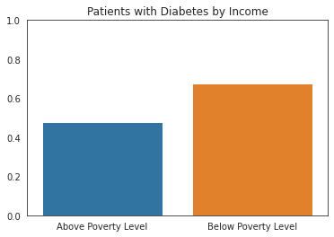
Patient’s Income
Analysis
The p-value is 1.97* 10^-244, which is a lot smaller than our alpha.
We reject Ho (null hypothesis) as the data provides convincing evidence to suggest Ho is wrong.
The difference in proportion between the patients with diabetes who make below poverty level income and patients who make above poverty level income is statistically significant, using a significance level of 0.05.
Patients that have diabetes and make below poverty level income is up by 19%, compared to patients that make above poverty level income.
Notes:
Above Poverty Level – 48%
Below Poverty Level – 67%
The bar plot shows that there were more patients with diabetes who made a below poverty level income.
P-value - how likely it is that your data would have occurred under the null hypothesis of your statistical test
A two proportion z-test allows you to compare two proportions to see if they are the same.

Slide 10
Project Summary and Recommendations
Findings from the study demonstrated that there is a statistically significant difference between patients who have diabetes and factors including their BMI, ability to see the doctor due to cost, and income.
Healthcare workers can promote strategies like losing weight, eating healthy, being active, and receiving medical treatments so patients can mitigate the harms of this disease in many patients.
Early diagnosis can lead to lifestyle changes and more effective treatment.
Further research can also investigate ways to help patients get benefits which can include health plans so they can afford going to see the doctors. After more analysis, making predictive models for diabetes risk can be used to make important tools for public and public health officials.
For reference:
The proposal is here.
The Colab Notebook is here.
Notes:
Due to these findings, I believe it is important for…
I believe…

Slide 11
Thank you!
Questions / Discussion

